Slide 1
Data Science Bootcamp
Midterm Project
Presented by Michael Boddy & Siu Kei Cheung @18 Mar 2022

Slide 2
Rent a house in New York City

Slide 3
Neighborhood Segmentation
Rent Prices (Studio)
Crime Rate
Rent Prices (1 bed)
No of Schools
Features
Rent Prices (2 beds)
No of Hospitals
Population
No of Bus Stations

Slide 4
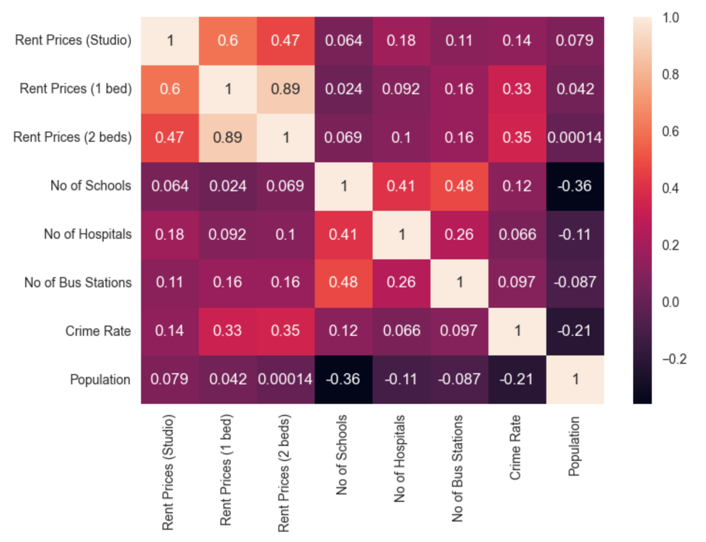
Neighborhood Segmentation
Features Correlations

Slide 5
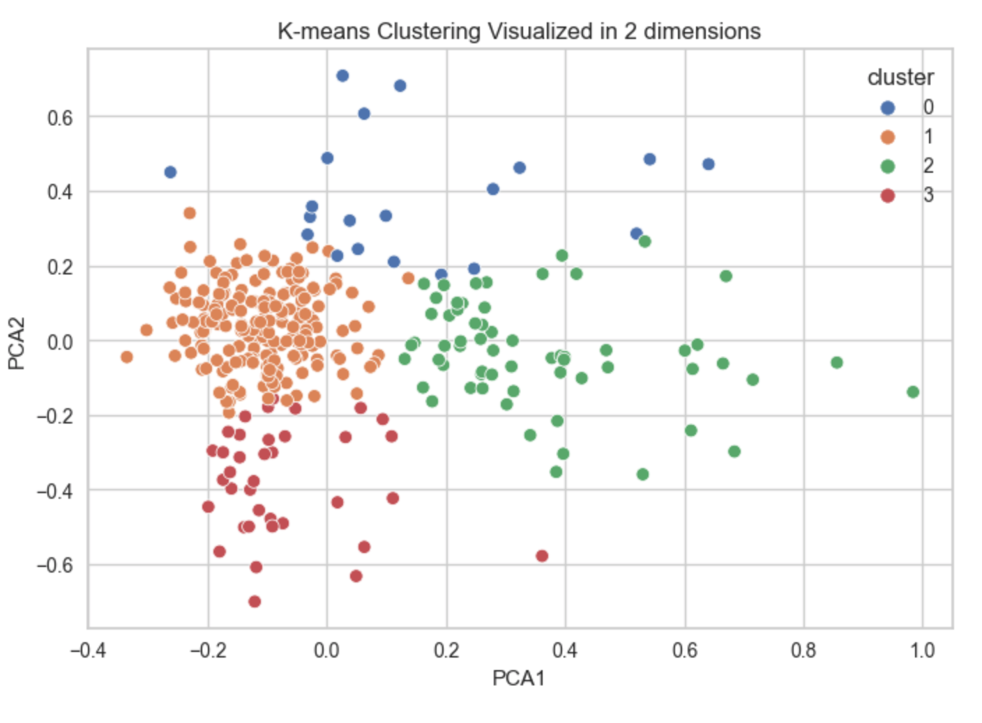
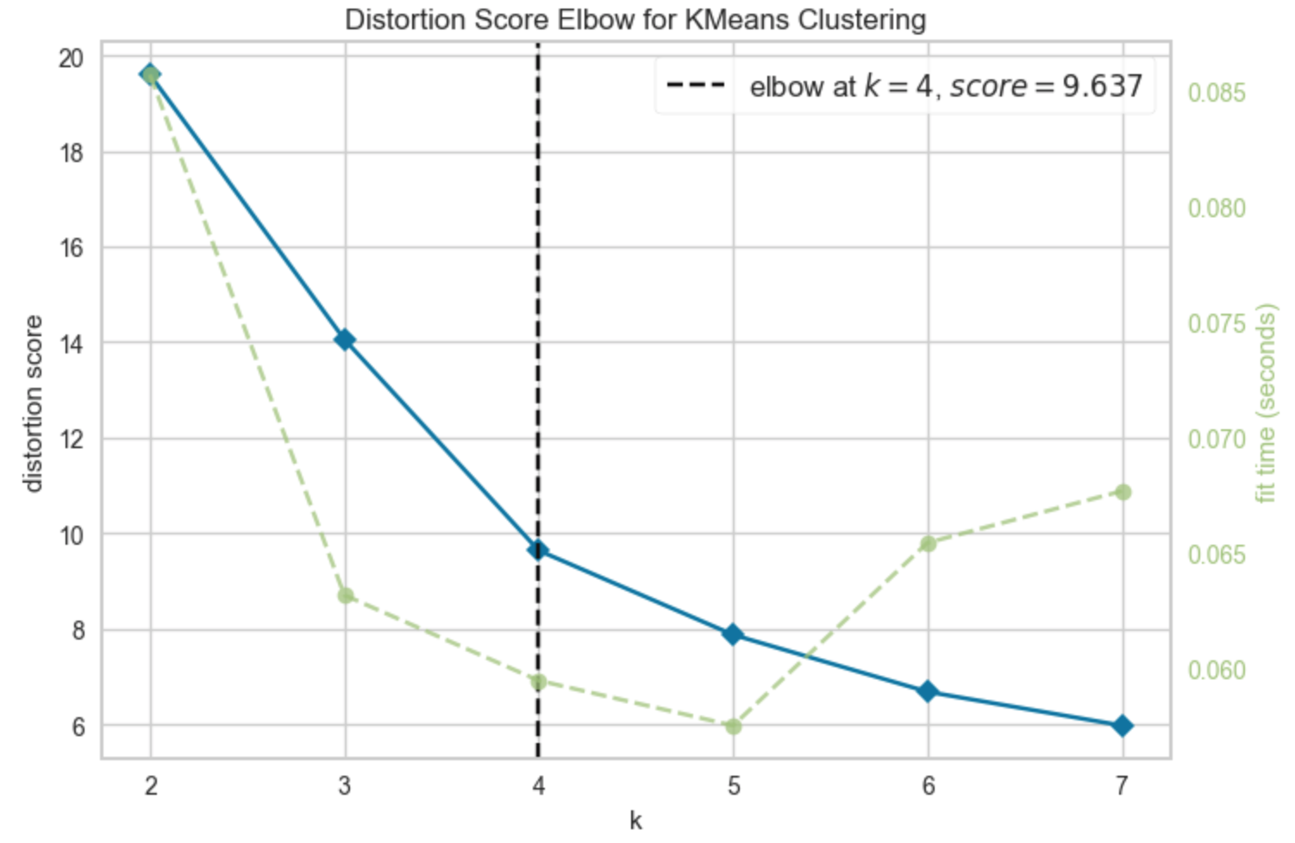
Neighborhood Segmentation
Clustering result
Kmeans

Slide 6
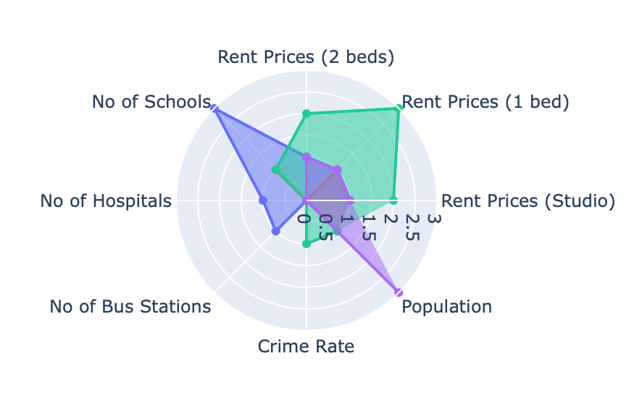
Neighborhood Segmentation
Clustering result
Kmeans

Slide 7
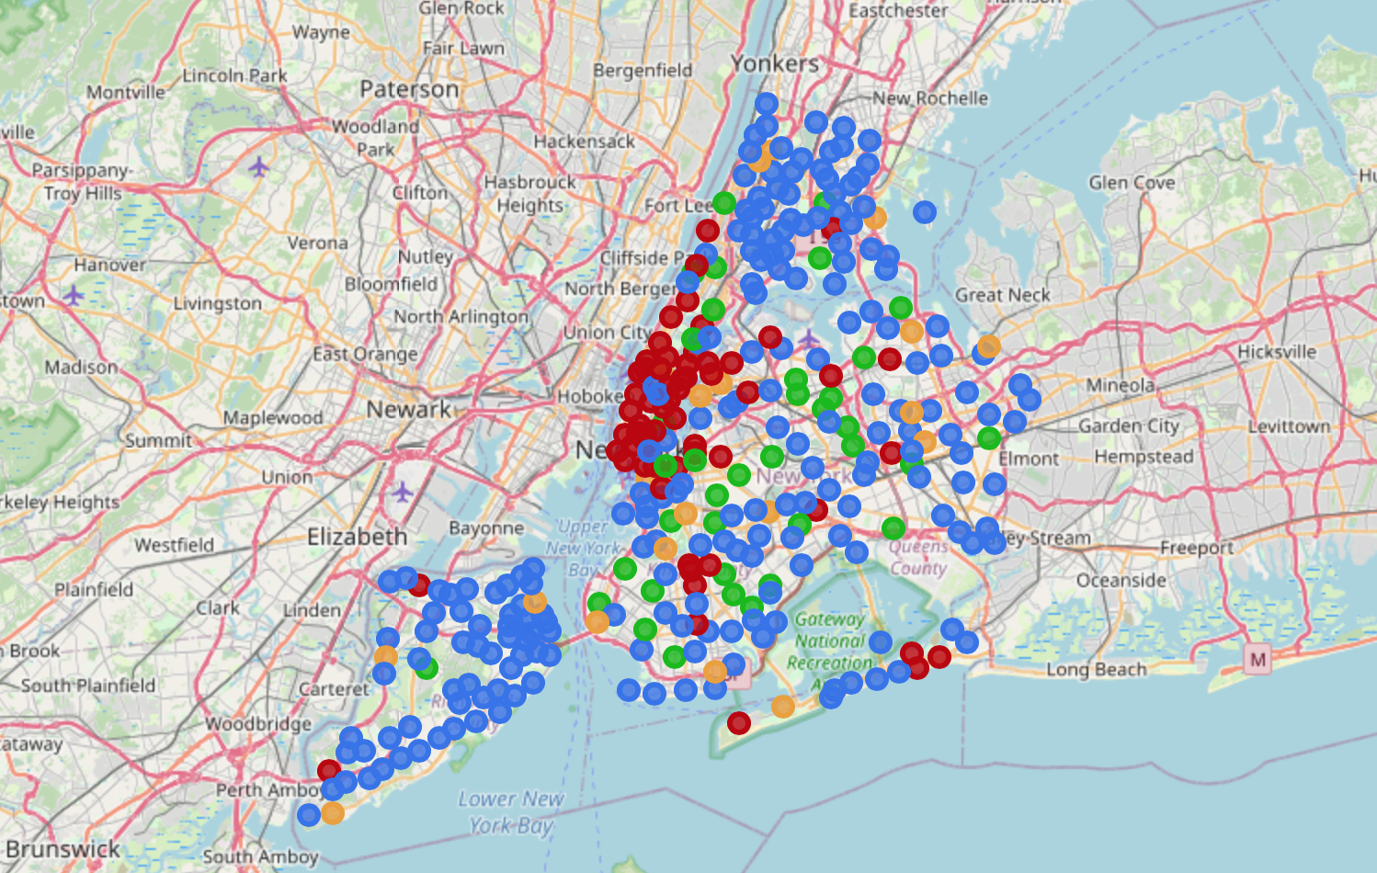
Neighborhood Segmentation
Kmeans

Slide 8
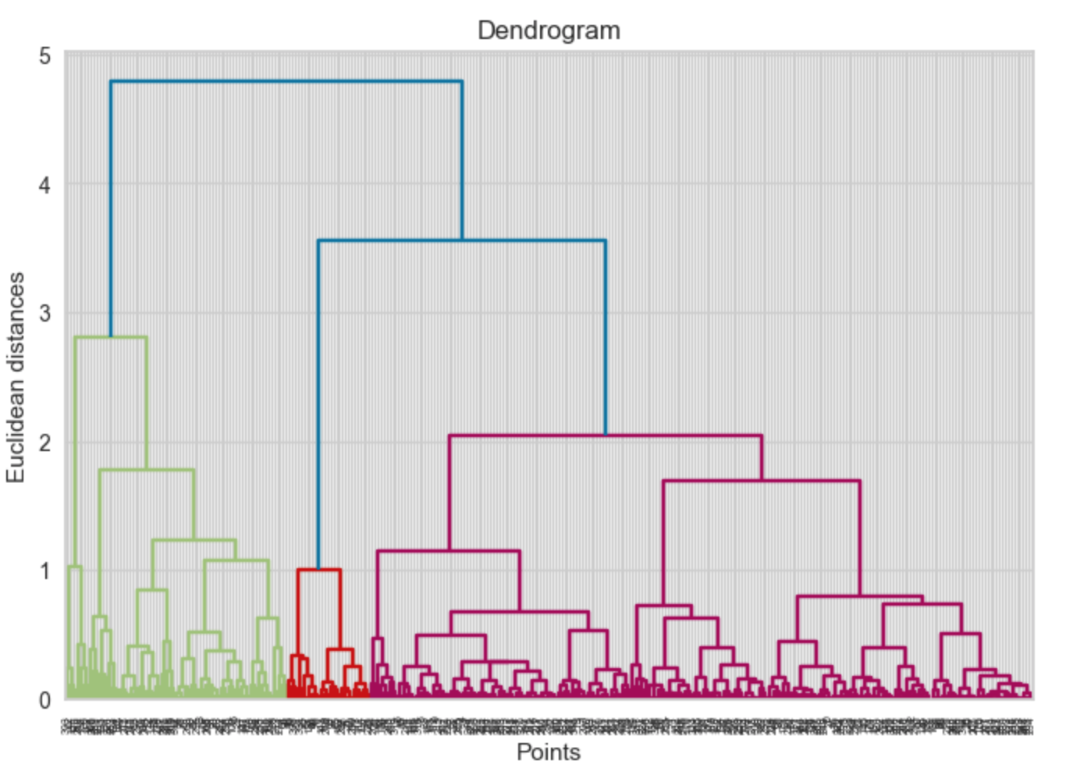
Neighborhood Segmentation
Clustering result
Hierarchical

Slide 9
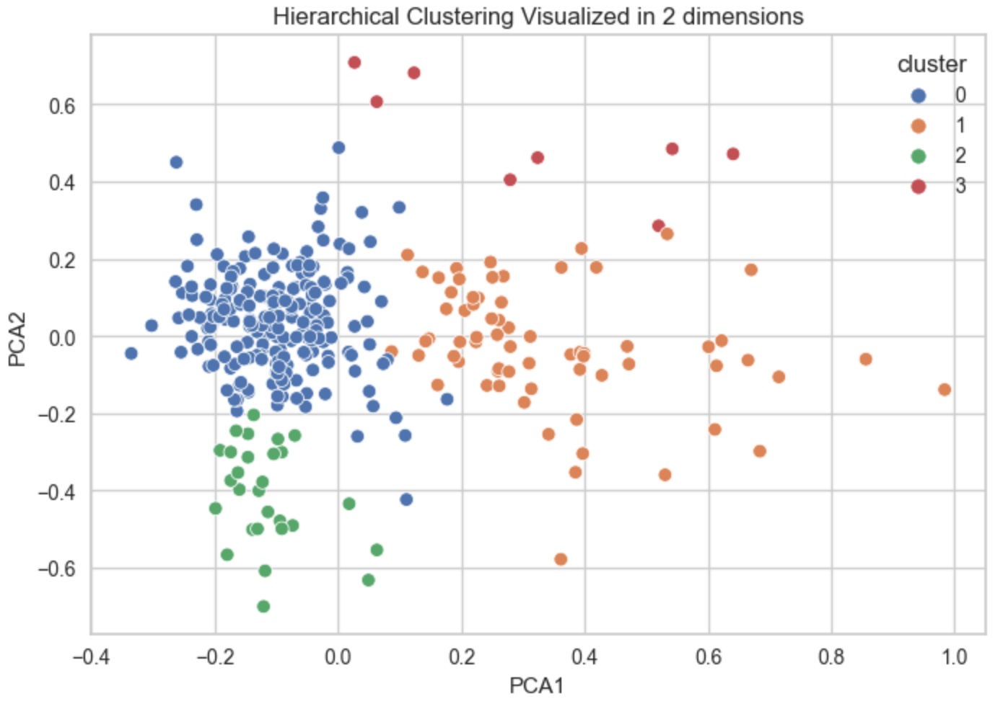
Neighborhood Segmentation
Clustering result
Hierarchical

Slide 10
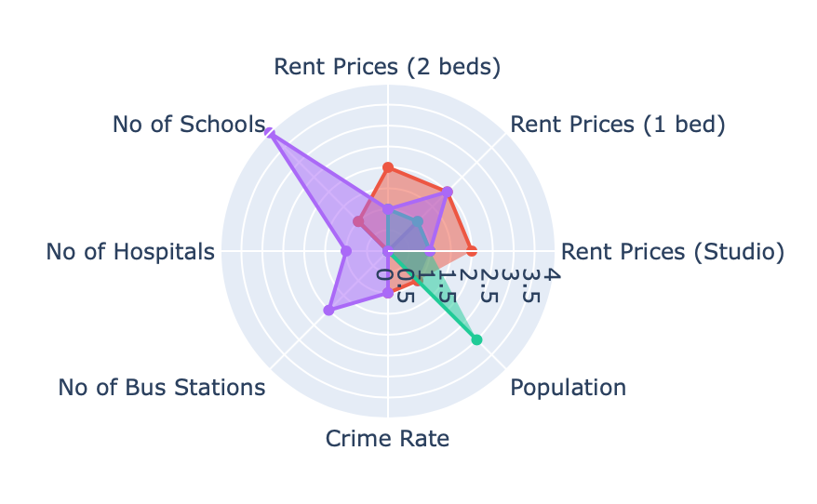
Neighborhood Segmentation
Clustering result
Hierarchical

Slide 11
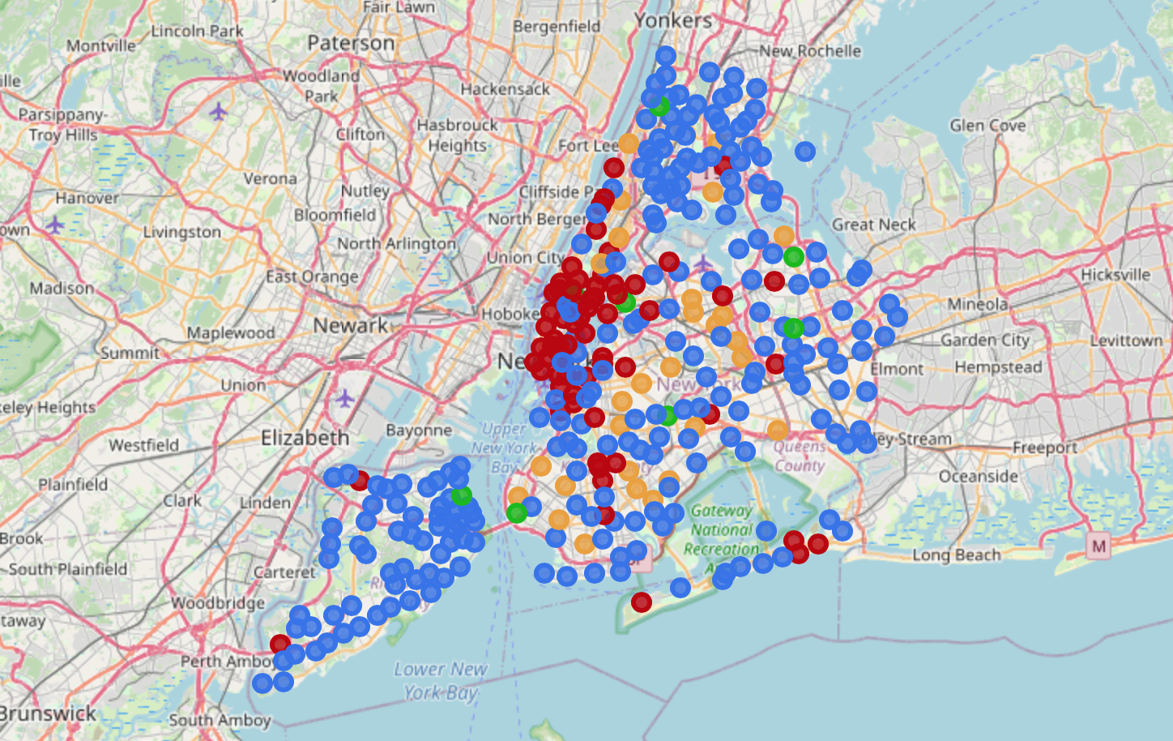
Neighborhood Segmentation
Hierarchical

Slide 12
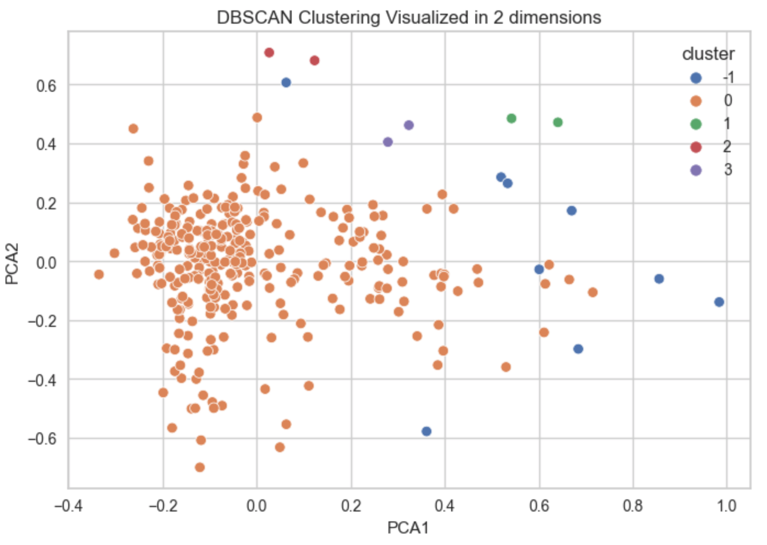
Neighborhood Segmentation
Clustering result
DBScan

Slide 13
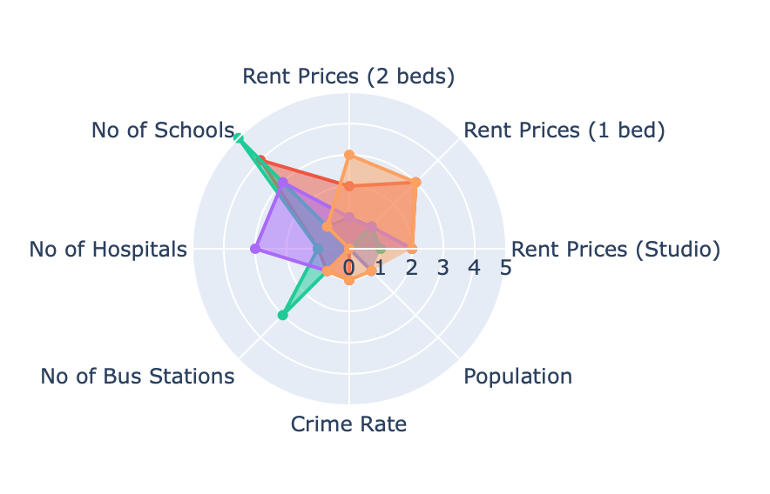
Neighborhood Segmentation
Clustering result
DBScan

Slide 14
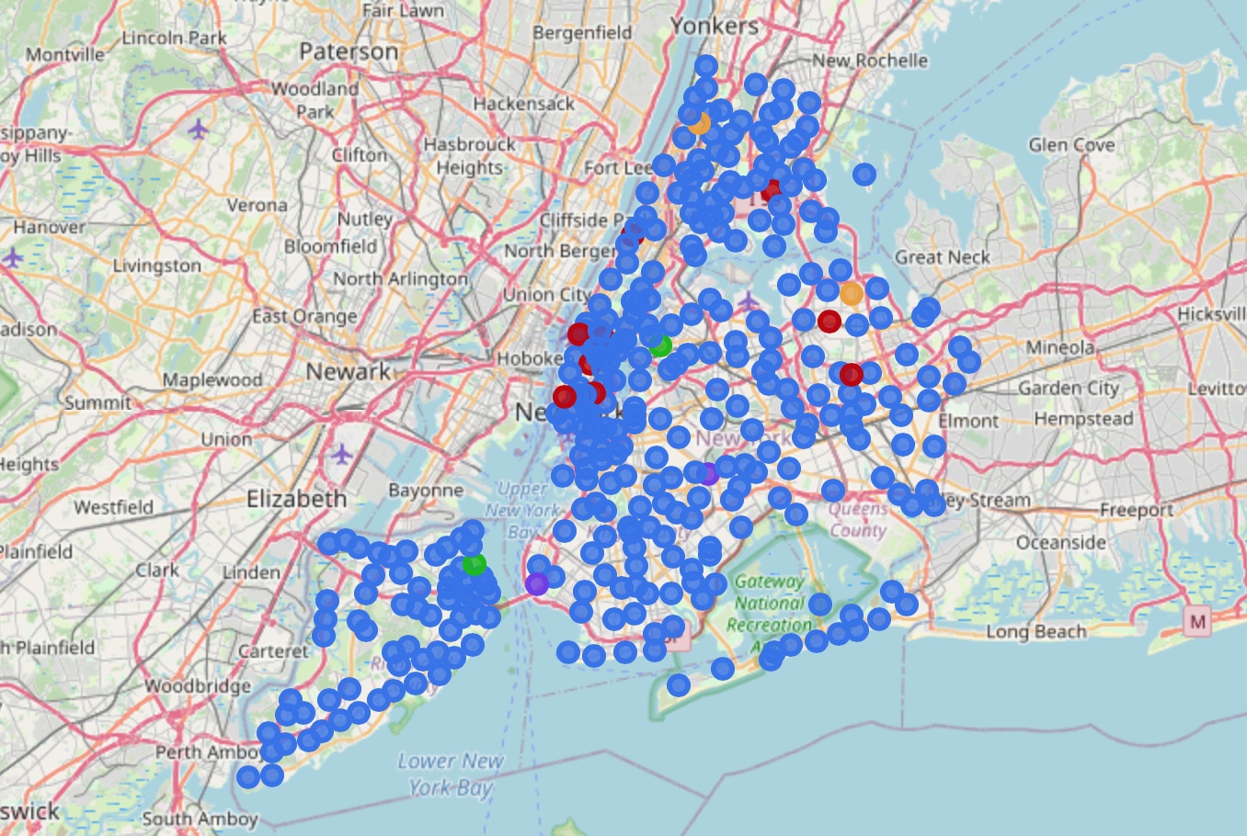
Neighborhood Segmentation
DBScan

Slide 15
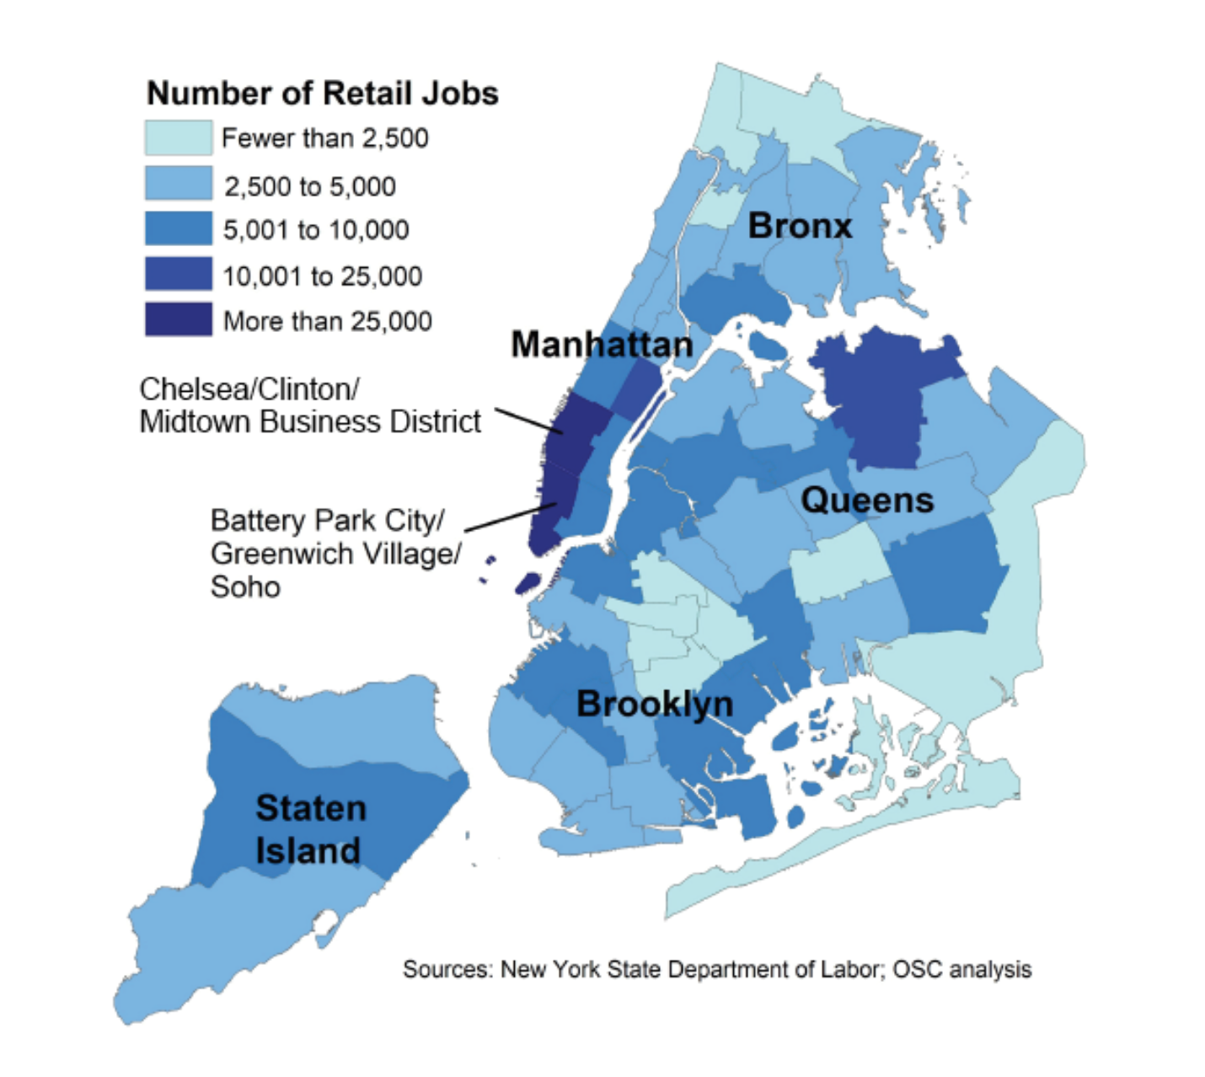
Neighborhood Segmentation
Analysis

Slide 16
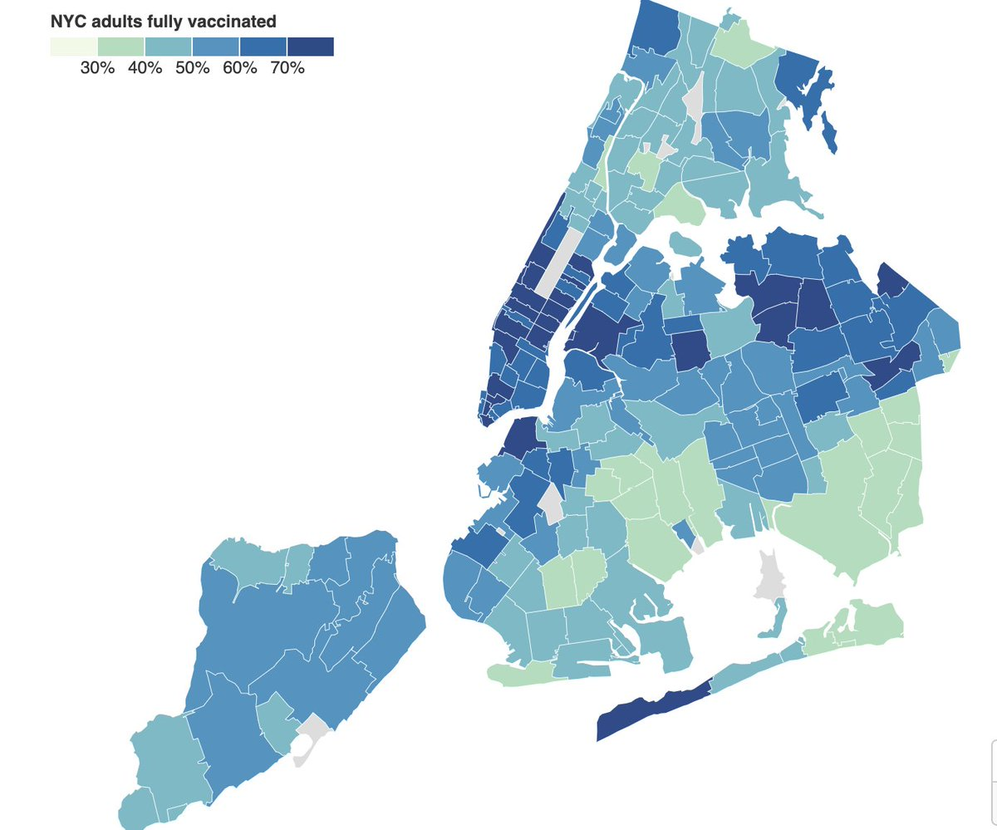
Neighborhood Segmentation
Analysis

Slide 17
Biggest Challenges
Data preparation
Features scaling
Standard Scaler VS MinMax Scaler
Silhouette Score Traps

Slide 18
THANK YOU FOR YOUR ATTENTION!
Michael Boddy & Siu Kei Cheung

